Slide 1
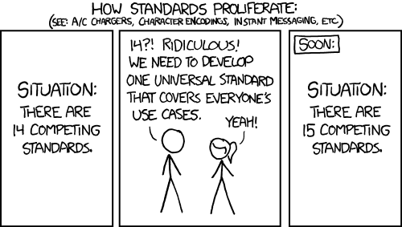
The Problem
Xkcd.com/927

Slide 2
Analogy: S&I Efforts
PDMP effort
DPROV effort
SDC effort
DAF effort
CQF effort
PDMP Model
DPROV Model
SDC Model
DAF Model
CQF Model
Simplification effort
CEDD effort
FHIM effort
Simplification Model
CEDD Model
FHIM Model
Business
Technical
Reference

Slide 3
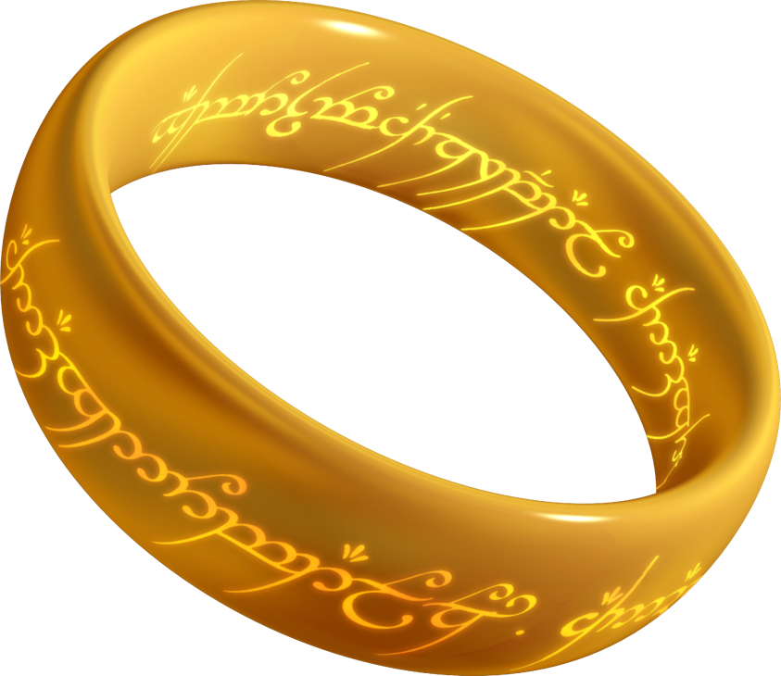
Efforts should be directed to harmonize on a single model.
PDMP effort
DPROV effort
SDC effort
DAF effort
CQF effort
PDMP Model
DPROV Model
SDC Model
DAF Model
CQF Model
Simplification effort
CEDD effort
FHIM effort
Simplification Model
CEDD Model
FHIM Model
Business
Technical
Reference

Slide 4
We believe that should be the FHIM
FHIM was designed from the start to harmonize requirements from different use cases and stakeholders.
FHIM provides a conceptual view for discussing business requirements but also supports logical views for specifications.
FHIM is built on MDHT, allowing us to generate implementable specifications and even code directly from the model.
MDHT can support the generation of different specifications (FHIR, CDA, HL7 V2, NEIM) from the same requirements model.

